Slide 1
TSQL 2012 Analytic Functions
Presented by
Steve Stedman
http://SteveStedman.com
Follow me on Twitter @SqlEmt

Slide 2
Presenter: Steve Stedman
DBA/Consultant/Trainer/Speaker/Writer
Been using SQL Server since 1991
Taught SQL Server classes at WWU
SQL Server consultant
Writer contributing to a new SQL Server book – Tribal SQL
Working at Emergency Reporting
Volunteer Firefighter and EMT
http://SteveStedman.com for more information.
http://SteveStedman.com
Follow me on Twitter @SqlEmt

Slide 3
SQL Server 2012
Introduced in Spring or 2012
Many new features and enhancements
Always On
Power View and Power Pivot
Column Store Index
And many others
Not part of this presentation
This presentation will focus on the TSQL Analytic specific new features enhancements

Slide 4
Analytic Functions Overview
OVER Clause Enhancements
ROWS PRECEDING, FOLLOWING, UNBOUNDED
RANGE PRECEDING, FOLLOWING, UNBOUNDED
LAG and LEAD
FIRST_VALUE and LAST_VALUE
PERCENT_RANK
PERCENTILE_DISC and PERCENTILE_CONT
CUME_DIST - Cumulative Distribution

Slide 5
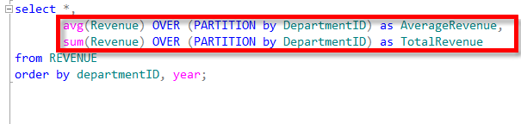
The Pre-2012 OVER Clause
The OVER clause before SQL Server 2012…
Really handy to perform aggregates over a different range than your standard grouping.

Slide 6
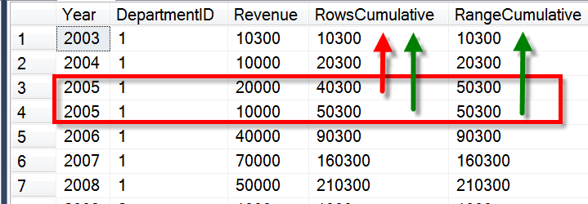
OVER Clause Enhancements
ROWS PRECEDING, FOLLOWING, UNBOUNDED
Rows refers to the current row and those before or after base on preceding or following.
RANGE PRECEDING, FOLLOWING, UNBOUNDED
Range means all values in the current range and those before or after.

Slide 7

ROWS / RANGE PRECEDING, FOLLOWING, UNBOUNDED
ROWS or RANGE- specifying rows or range
PRECEDING – get rows before the current one
FOLLOWING – get rows after the current one
UNBOUNDED – get all before or after
CURRENT ROW

Slide 8
ROWS/RANGE PRECEDING, FOLLOWING, UNBOUNDED - Demo
--ROWS PRECEDING
-- http://stevestedman.com/?p=1454
-- look at the sum of revenue over a trailing 3 year period
select Year, DepartmentID, Revenue,
sum(Revenue) OVER (PARTITION by DepartmentID
ORDER BY [YEAR]
ROWS BETWEEN 3 PRECEDING AND CURRENT ROW) as Prev3
from REVENUE order by departmentID, year;
--ROWS PRECEDING
select Year, DepartmentID, Revenue,
sum(Revenue) OVER (PARTITION by DepartmentID
ORDER BY [YEAR]
ROWS BETWEEN 5 PRECEDING AND 2 PRECEDING) as Prev5to3
from REVENUE order by departmentID, year;
-- ROWS FOLLOWING
-- http://stevestedman.com/?p=1454
select Year, DepartmentID, Revenue,
sum(Revenue) OVER (PARTITION by DepartmentID
ORDER BY [YEAR]
ROWS BETWEEN CURRENT ROW AND 3 FOLLOWING) as Next3
from REVENUE order by departmentID, year;
--ROWS PRECEDING
select Year, DepartmentID, Revenue,
sum(Revenue) OVER (PARTITION by DepartmentID
ORDER BY [YEAR]
ROWS BETWEEN 1 PRECEDING AND 1 FOLLOWING) as BeforeAndAfter
from REVENUE order by departmentID, year;

Slide 9
LAG and LEAD
Allows you to reference a value in a row before or a row after the current row
Over clause is used to specify the ordering and partitioning

Slide 10
FIRST_VALUE and LAST_VALUE
FIRST_VALUE returns the first value in an ordered set of values and
LAST_VALUE returns the last value in an ordered set of values
Utilize the OVER clause to set ranges and orders
Interesting catch – LAST_VALUE specifies the last value so far unless you specify otherwise

Slide 11
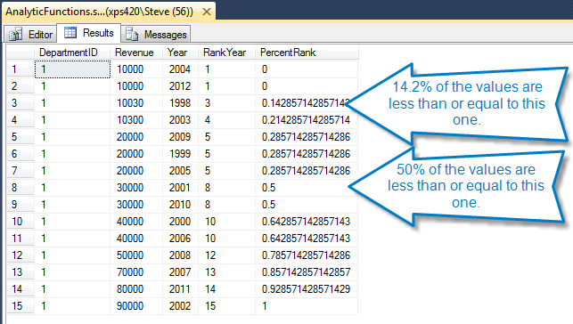
PERCENT_RANK
PERCENT_RANK is defined as the number of values that are the same or less than the current value divided by one less than the number of values
Different from PERCENTILE

Slide 12
PERCENTILE_DISC and PERCENTILE_CONT
PERCENTILE_CONT interpolates the appropriate value, even if it is not in the set
PERCENTILE_DISC picks a percentile that exists in the set.
Keep in mind that any nulls in the data set are ignored.
What’s the difference in the names
CONT stands for continuous
DISC stands for discrete distribution which means that the percentile will exist in the set.

Slide 13
CUME_DIST - Cumulative Distribution
CUME_DIST is the function that maps values to their percentile rank in a distribution.
The CUME_DIST function calculates the possibility of another occurrence being of that value or lesser than that among a group of values.

Slide 14
More statistics with Cumulative Distribution
Testing the Rand() function
Testing probability with dice rolls

Slide 15
In Review
OVER Clause Enhancements
ROWS PRECEDING, FOLLOWING, UNBOUNDED
RANGE PRECEDING, FOLLOWING, UNBOUNDED
LAG and LEAD
FIRST_VALUE and LAST_VALUE
PERCENT_RANK
PERCENTILE_DISC and PERCENTILE_CONT
CUME_DIST - Cumulative Distribution

Slide 16
More Information
Follow me on Twitter
@SqlEmt
Visit my website
http://stevestedman.com/
Send me an email:
Steve@SteveStedman.com
Download Slides and Sample TSQL
http://stevestedman.com/speaking/
Up Next…. Unleashing Common Table Expressions

